Slide 1






PART 2: UNCERTAINTY QUANTIFICATION TECHNIQUES AND HANDS-ON
Presenters: Nataliia Molchanova and Vatsal Raina
Acknowledgements:
Federico Spagnolo, Pedro M. Gordaliza, Mara Graziani, Francesco La Rosa, Andrey Malinin, Mark Gales, Cristina Granziera, Henning Müller, and Meritxell Bach Cuadra
This work was supported by the Hasler Foundation Responsible AI programme (MSxplain project)

Slide 2
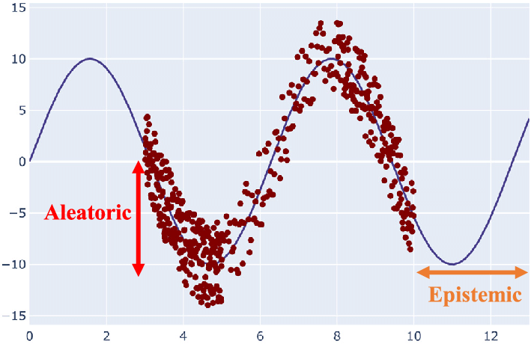
SOURCES OF UNCERTAINTY
PREDICTIVE
UNCERTAINTY
M. Abdar, Information Fusion, 2021

Slide 3
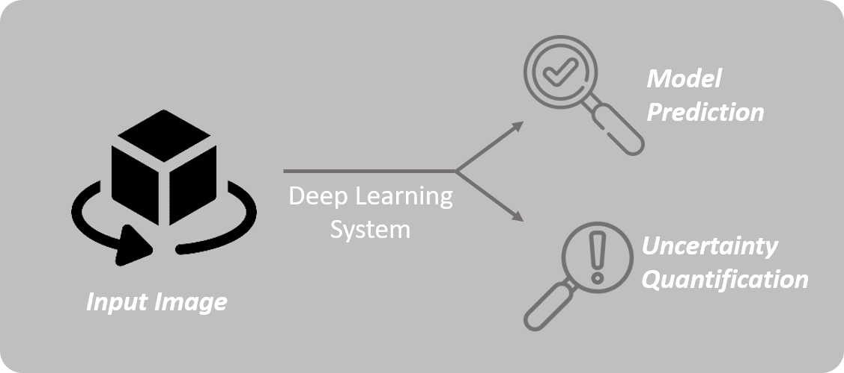
OVERALL PIPELINE

Slide 4
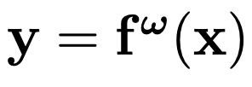
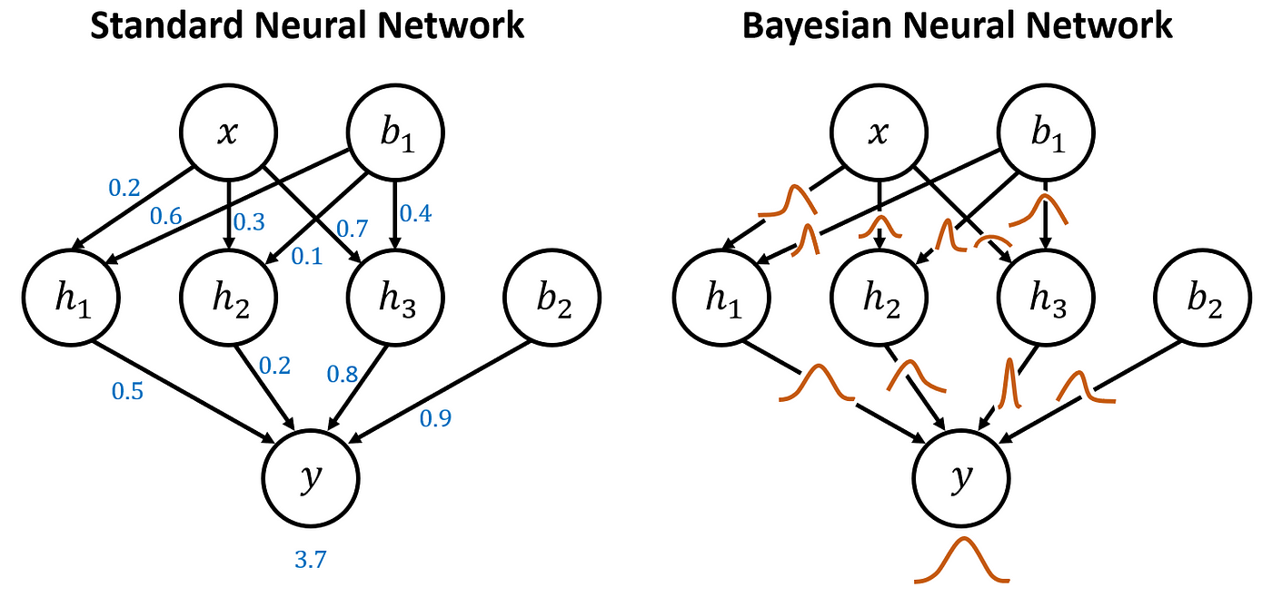

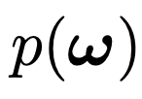
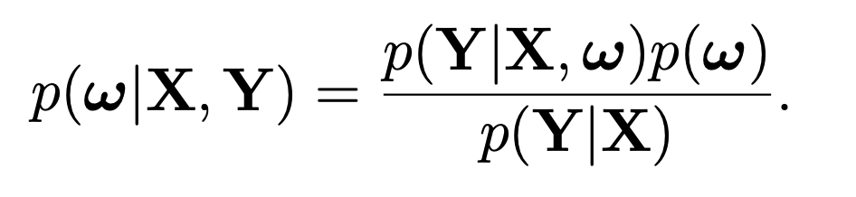
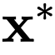
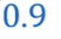
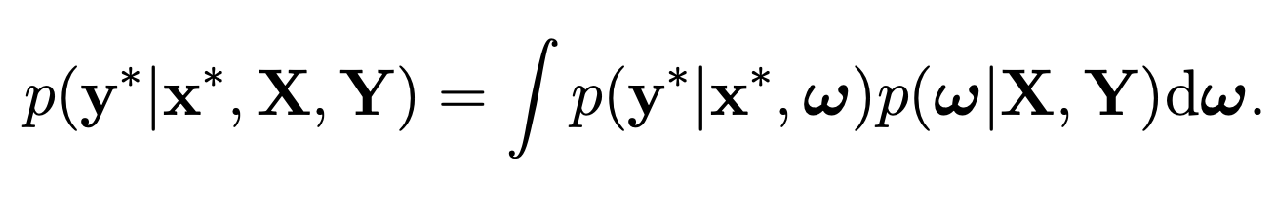
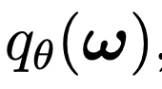
BAYESIAN PERSPECTIVE ON UNCERTAINTY
Given training inputs and outputs:
Goal: find parameters of a function that is likely to have generated the outputs:
For a new input use Bayesian inference:
Cannot evaluate analytically
Hence, searching for approximating variational distribution
Y. Gal, PhD thesis, 2016

Slide 5
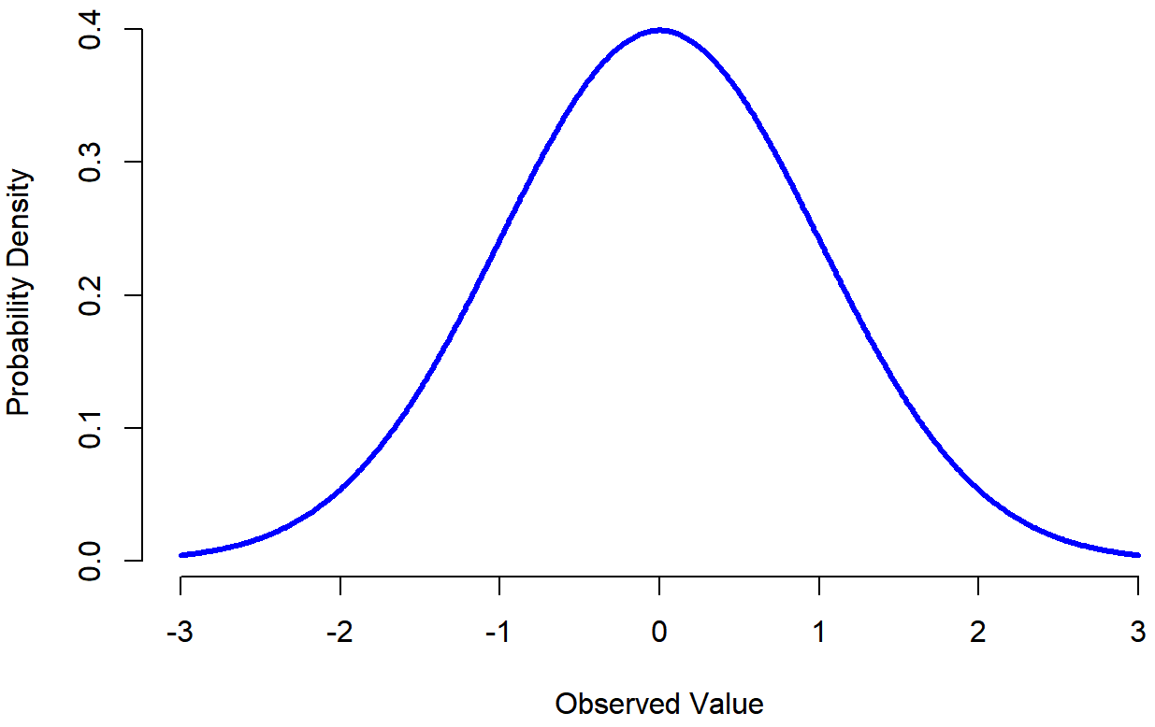
ENSEMBLING-BASED APPROACHES
“Each model in an ensemble of models takes a different sample of weights from the posterior distribution”

Slide 6
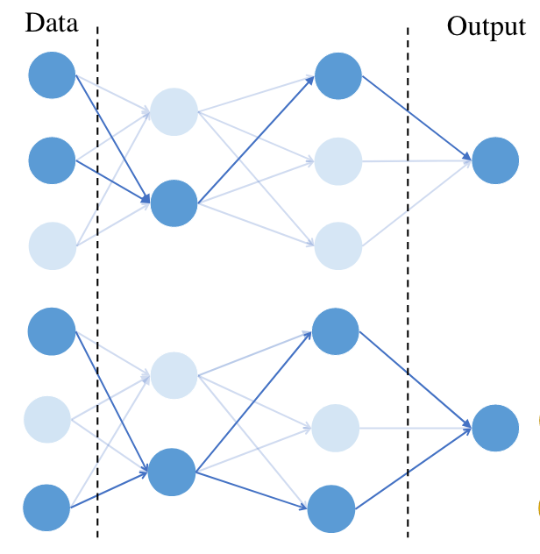
MONTE CARLO DROPOUT (MCDP)
Dropout in an ANN
MCDP Inference time:
Sampling from the posterior
Dropout mask seen as a random variable that induces a distribution over the weights and biases of the network
0.7
0.8
0.3
Gal et al, ICML 2016.

Slide 7
DEEP ENSEMBLES
Training
Inference
Initialise the network weights with different sets of random weights
Seed 1
Seed 2
Seed 3
Seed 1
Seed 2
Seed 3
0.7
0.8
0.3
Lakshminarayanan et al, Neurips 2017.

Slide 8
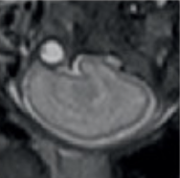
TEST TIME AUGMENTATIONS (TTA)
Input image
Flipped
input image
Flipped
input image
0.7
0.8
0.3
Possible transformations: any invertible spatial transformation (e.g. flipping, scaling, rotation and translation)
Wang et al, Neurocomputing, 2019.

Slide 9
UNCERTAINTY MEASURES - examples
Regression
Classification
0.7
0.8
0.3
0.2
0.5
0.3
0.1
0.5
0.4
0.2
0.6
0.2
“Variance”
“Entropy of Expected”

Slide 10
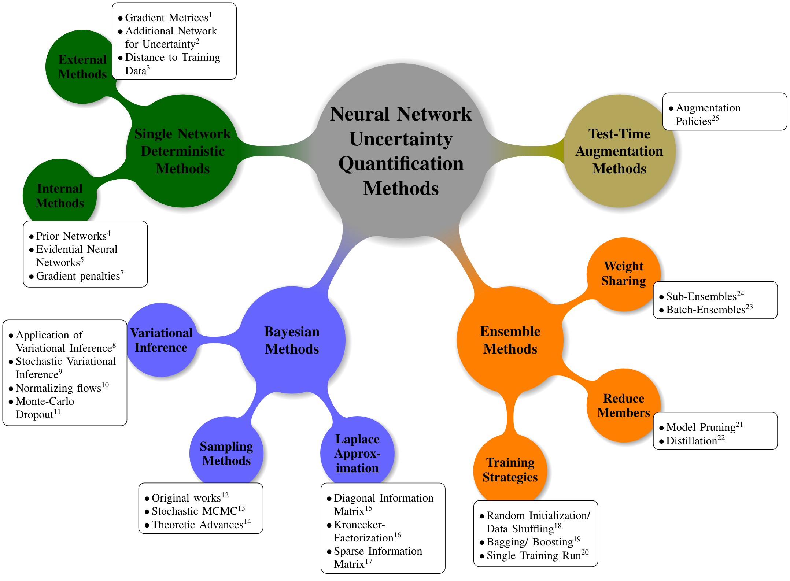
OTHER
UQ METHODS
Gawlikowski et al, ArXiv 2022.

Slide 11
How to choose
an UQ method?
“A good uncertainty measure is one that correlates with the errors of a model”
UQ1
UQ2
Performance
Data Retained
Ultimately, the choice of uncertainty quantification method depends on the specific requirements of your deep learning task, the available resources, and the desired level of uncertainty estimation.
Malinin et al, Neurips 2021 ; N. Molchanova et al, ISBI 2023

Slide 12






UNCERTAINTY
QUANTIFIED.
WHAT’S NEXT?
Quality Assessment [1]
Active Learning [2]
Boosting Performance [3]
Domain Adaptation [4]
[1] Nemani et al, ArXiv 2023.
[2] Hein et al, IEEE 2022.
OOD Detection [5]
Trustworthiness [2]
[3] Ahmed et al, Springer 2023.
[4] Roy et al, Springer 2022.
[5] Delayney et al, Arxiv 2021.

Slide 13
HANDS-ON

